Slide 1


FOR INTERNAL USE ONLY
GPT as Proto-Editor: Automating Some Document Editing Tasks
SCAN Brownbag Seminar
By JOHN VAHEDI, 8/8/23
Notes:
Unique perspective on how LLM acts.
Dive into parameter space “knobs”
Future research technical concerns
Honestly a lot of results, hard to parse, “hear your thoughts”
5 days for task, not complete product but POC
Main: viability of tool BUT learned couple things want share, esp. misconceptions
GPT “Editor” as Proto-Editor, not meant to do what an Editor does

Slide 2
Overview of Topics
Background
GPT as Future Research Tool
Suggested Method
Pubs Process
Sponsor Needs
GPT Proto-Editor
Exploring Finetuning
GPT 3.5 vs 4
Reproducibility in Randomness
Conclusion on findings
Framework for parameters
Future Proposal Method
Prompt Engineering
Behaviors and Results
Next Steps

Slide 3
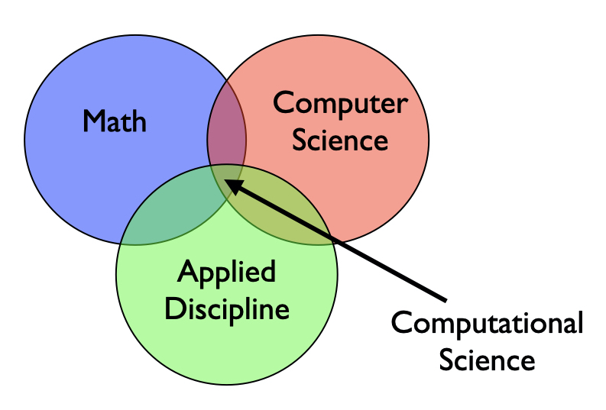

A Little About Me:
JOHN VAHEDI
Technical Analyst III
Relevant Work:
Coding Transformers
Simulations
Background:
Educational Technology
Applied Mathematics
Scientific Computing
Notes:
Math CS: theory needs comp sol
Math Applied: ungrounded and cleansed
Comp sci
Build tools and models, data communication and visualization.

Slide 4

Background
Current Pubs Pipeline
QA
Editing
Publish
Sponsor
Draft
“…recommendation is to offer more streamlined production options for all of our publications to greatly speed up the publication process.”
–Jason Matheny [source]
Grammarly will, at the choice and written request of Customer, delete any Customer Data in its possession within a commercially reasonable time…
--Grammarly [source]
Data Protection Matrix
Notes:
Parallel CUI Document
LLM can do editing
Proofreading included

Slide 5
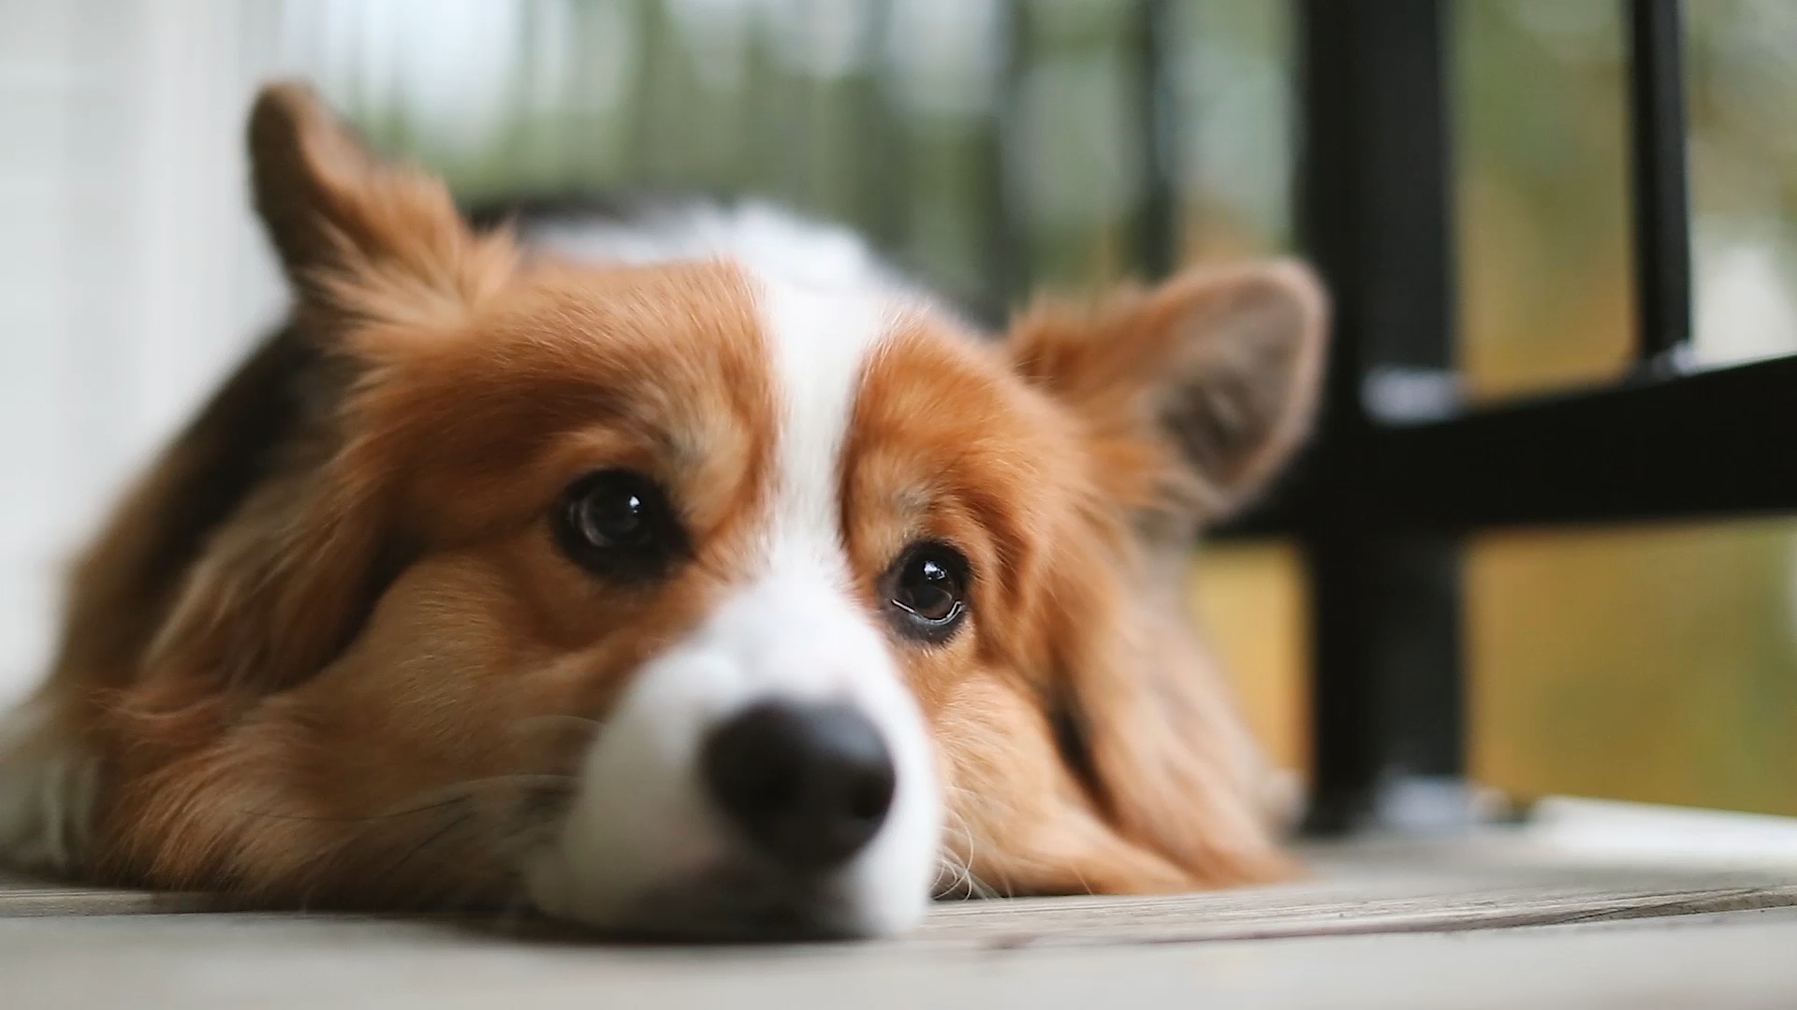
Pain Points around Early Drafts to Sponsors
Sponsor may want draft before Pubs process can be navigated
Clear up “grammar” issues first
A need for quicker timelines to publishing
Can speed up task rate of Pubs by prescreening via GPT
Notes:
corgi

Slide 6
Possible Alternative Pubs Pipeline
A simplified example…
Pre-QA
Document
GPT
QA
Editing
Publish
Sponsor
Draft
Notes:
Focus on the big picture from sponsor, remove little details.

Slide 7
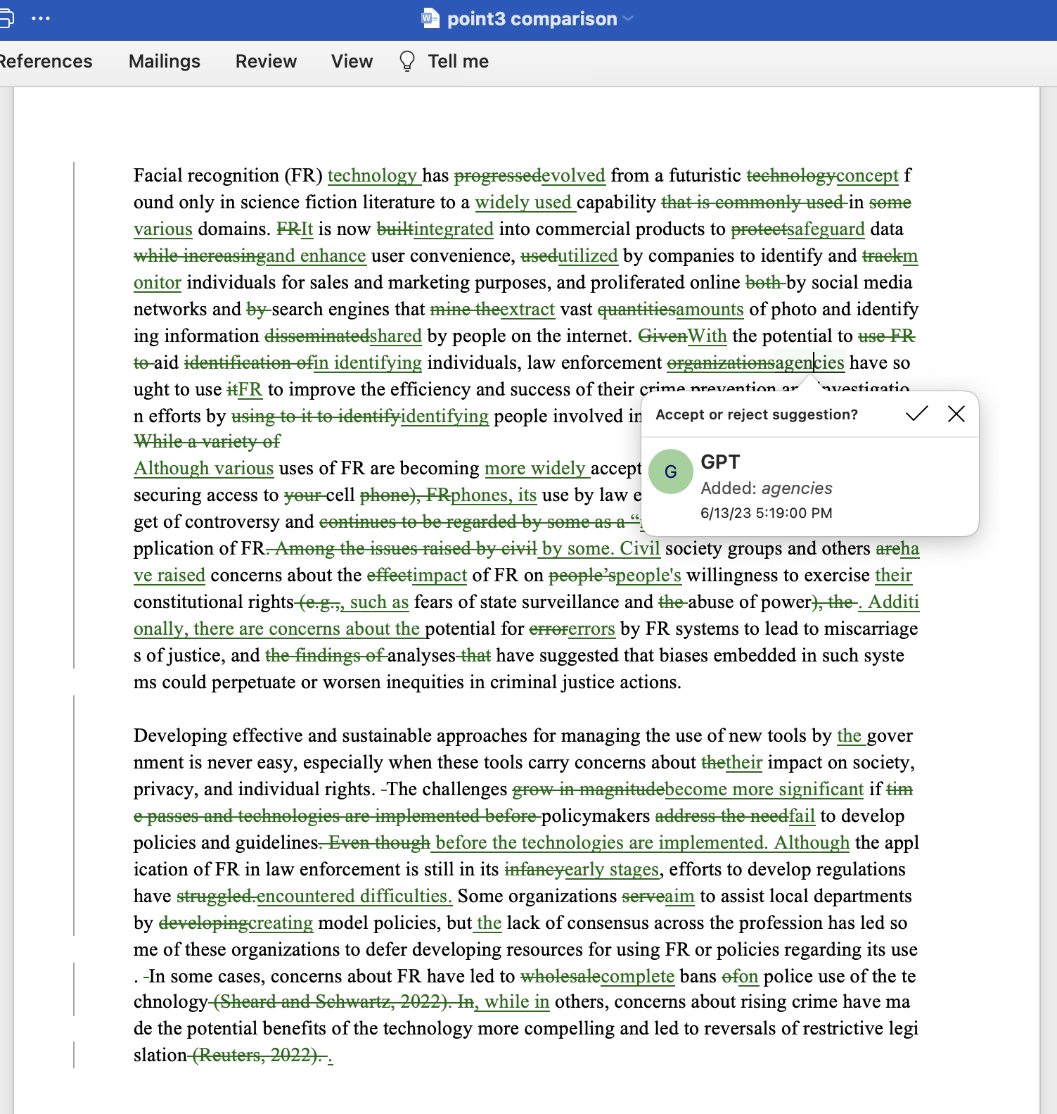


GPT Method Implemented in Early Review
Pre-QA
Document
QA
Merge
GPT
Prompt +
Parameters
Notes:
Can not just accept edits, suggested merges is more helpful and viable

Slide 8
GPT as Part of Early Review Process
Viable?
1.Quality of “Edits”
2. Number of “Edits”
If so, then how?

Slide 9
GPT as Proto-Editor
LLM Knobs
Prompt Engineering
Parameter Tuning
GPT 4
Class Decision
GPT 3.5
Temperature
“Grammar”
Top_p
“Clarity”
“Style”
Parameter Space :
Support? Reach out to istservicedesk@rand.org
Feedback? Contact jbartle@rand.org

Slide 10
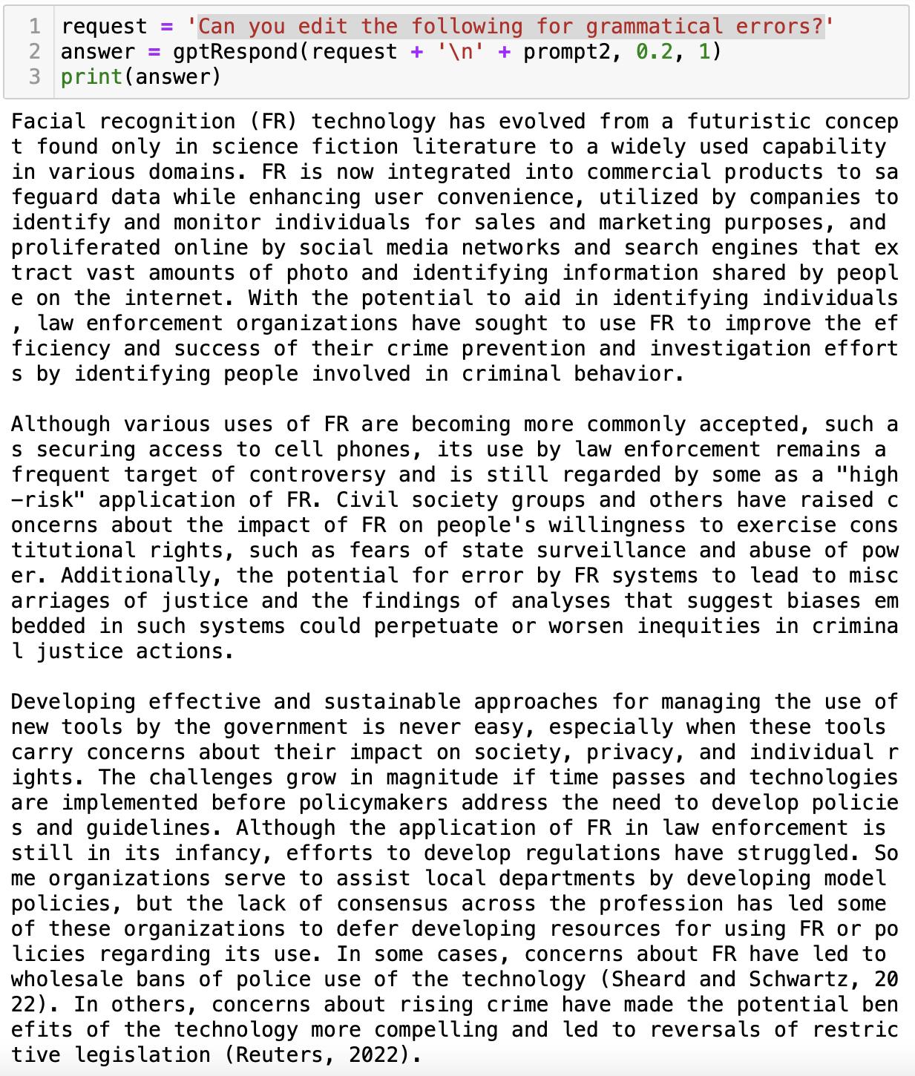
Example Prompts:
‘Can you edit the following for grammatical errors?’
‘I am a researcher writing for publication. Can you edit the following for grammatical errors and clarity?’
'Can you edit the following for grammatical errors and clarity?'
#Mention bad prompts
'Can you review the following for grammar mistakes?'
‘Can you review the following for possible edits?’
Notes:
These were successful prompts.
#Mention bad prompts
Information could have been given as a spoken list of tasks.
Clarity messed with the citations and overcorrected.

Slide 11
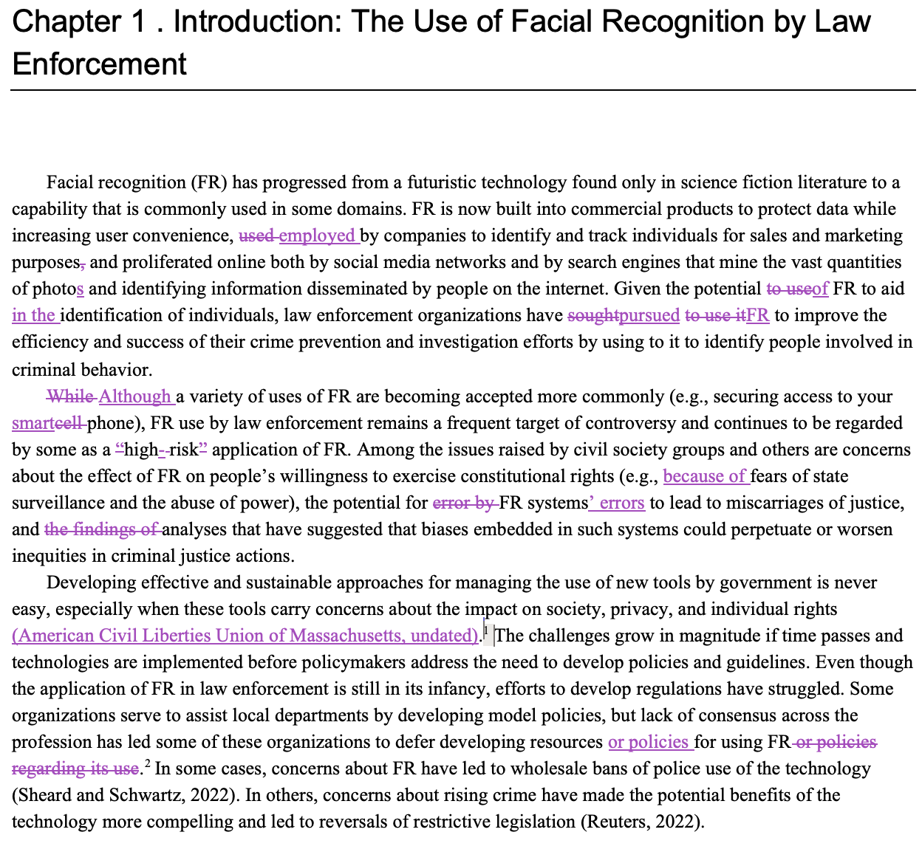
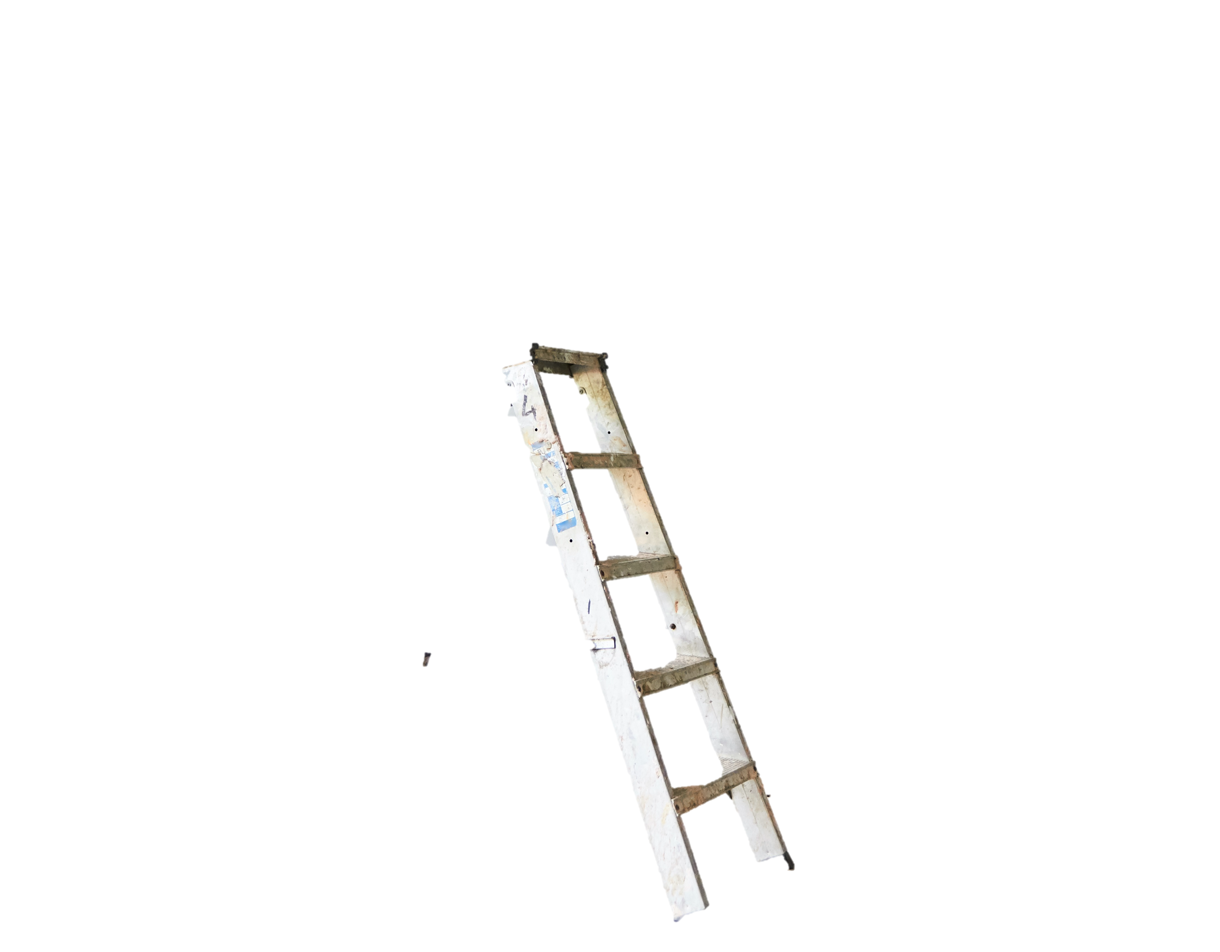
Rungs of Possible Edits
Style
Clarity
Original RAND Research Editor
Grammar
Notes:
RAND Product here
Spectrum, and easy to go from one rung to the next

Slide 12
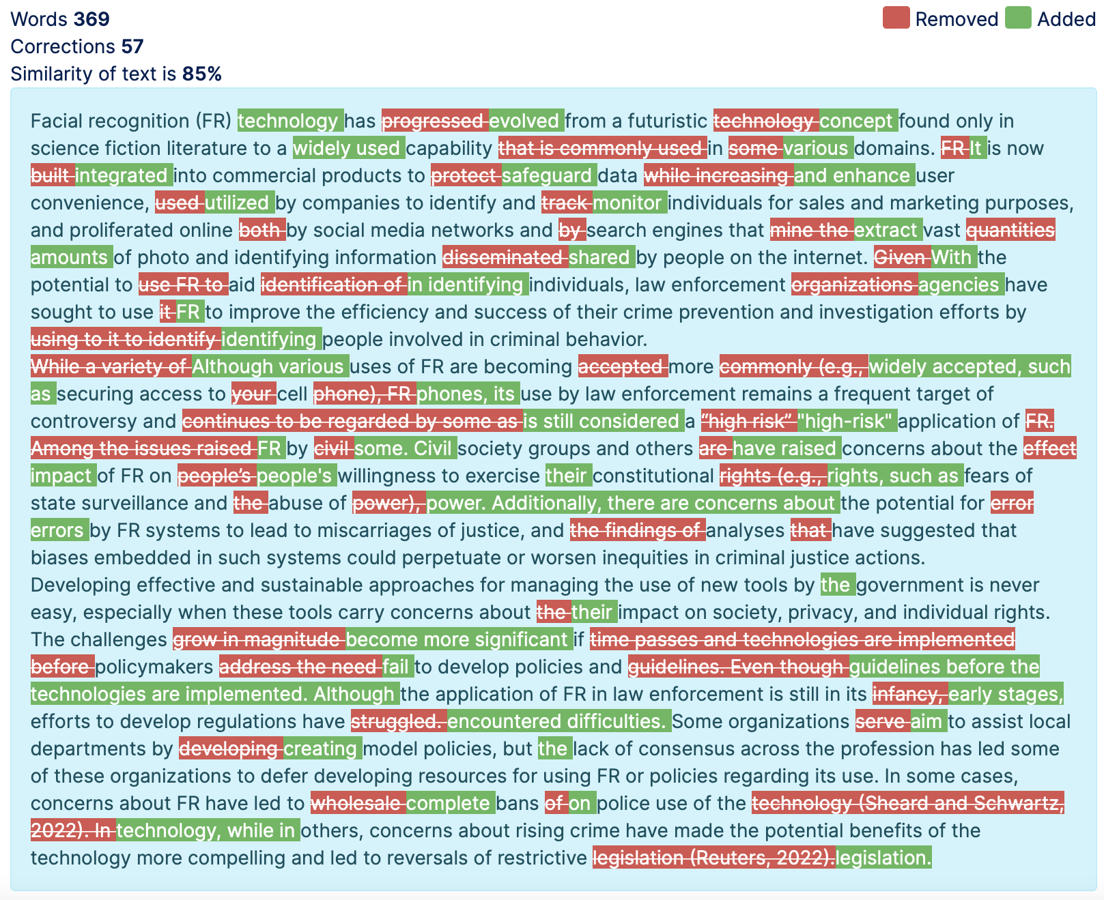
Comparison of Editors
With Default Parameters
GPT “Editor”
Original RAND Research Editor
Notes:
Not just spellcheck, look at “although”.
Correctly identifies many, but overkill and may change format if leaned into
Benefits was I had this, a comparison

Slide 13
Comparison of Editors
With Default Parameters
Observations on Quality
Often did capture some good edits:
Reworded awkward WC/phrasing
Mirrored some human edits (inconsistent)
Caught missed edits
Could be a bit busy/aggressive
Weird Behaviors:
Removing citations (sometimes)
Combining paragraphs (randomly)
Simplifications may alter meaning (rare)
Can not execute high-level edits
GPT “Editor”
Notes:
In small sample:
Not just spellcheck, look at “although”.
Correctly identifies many, but overkill and may change format if leaned into
Benefits was I had this, a comparison
Unpredictable with more words, eventually returns to stable, not paid enough

Slide 14
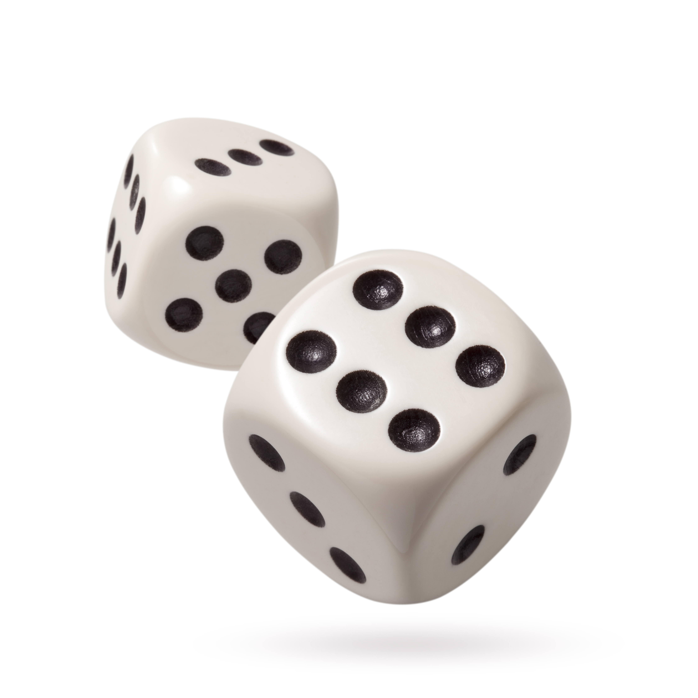














Framework for Parameter Action
Parameters Documentation
Action
Items:
…
Probability:
.4
.2
.1
.06
.04
.03
.03
.01
GPT
Notes:
TO understand how change behavior, we understand framework
Wholesale edits, not blended
Think of Rand grant proposal

Slide 15

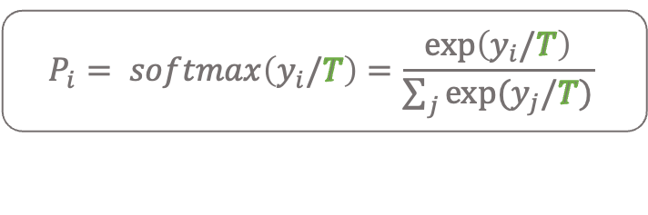
Framework for Parameter Action (1)
Temperature
0 < T < 2 , Default = 1
SoftMax Sandbox
.6
$$P_{i}= softmax\left(y_{i}/T\right)=\frac{exp\left(y_{i}/T\right)}{\sum_{j}{exp⁡(y_{j}/T)}}$$
.25
+.2
.1
+.05
+0
…
T ~ .5
Probability:
.4
.2
.1
.06
.04
.03
.03
.01
-.01
-.02
-.025
-.025
.05
.02
.005
.005
.001
Notes:
But what is the meaning of left to right?

Slide 16
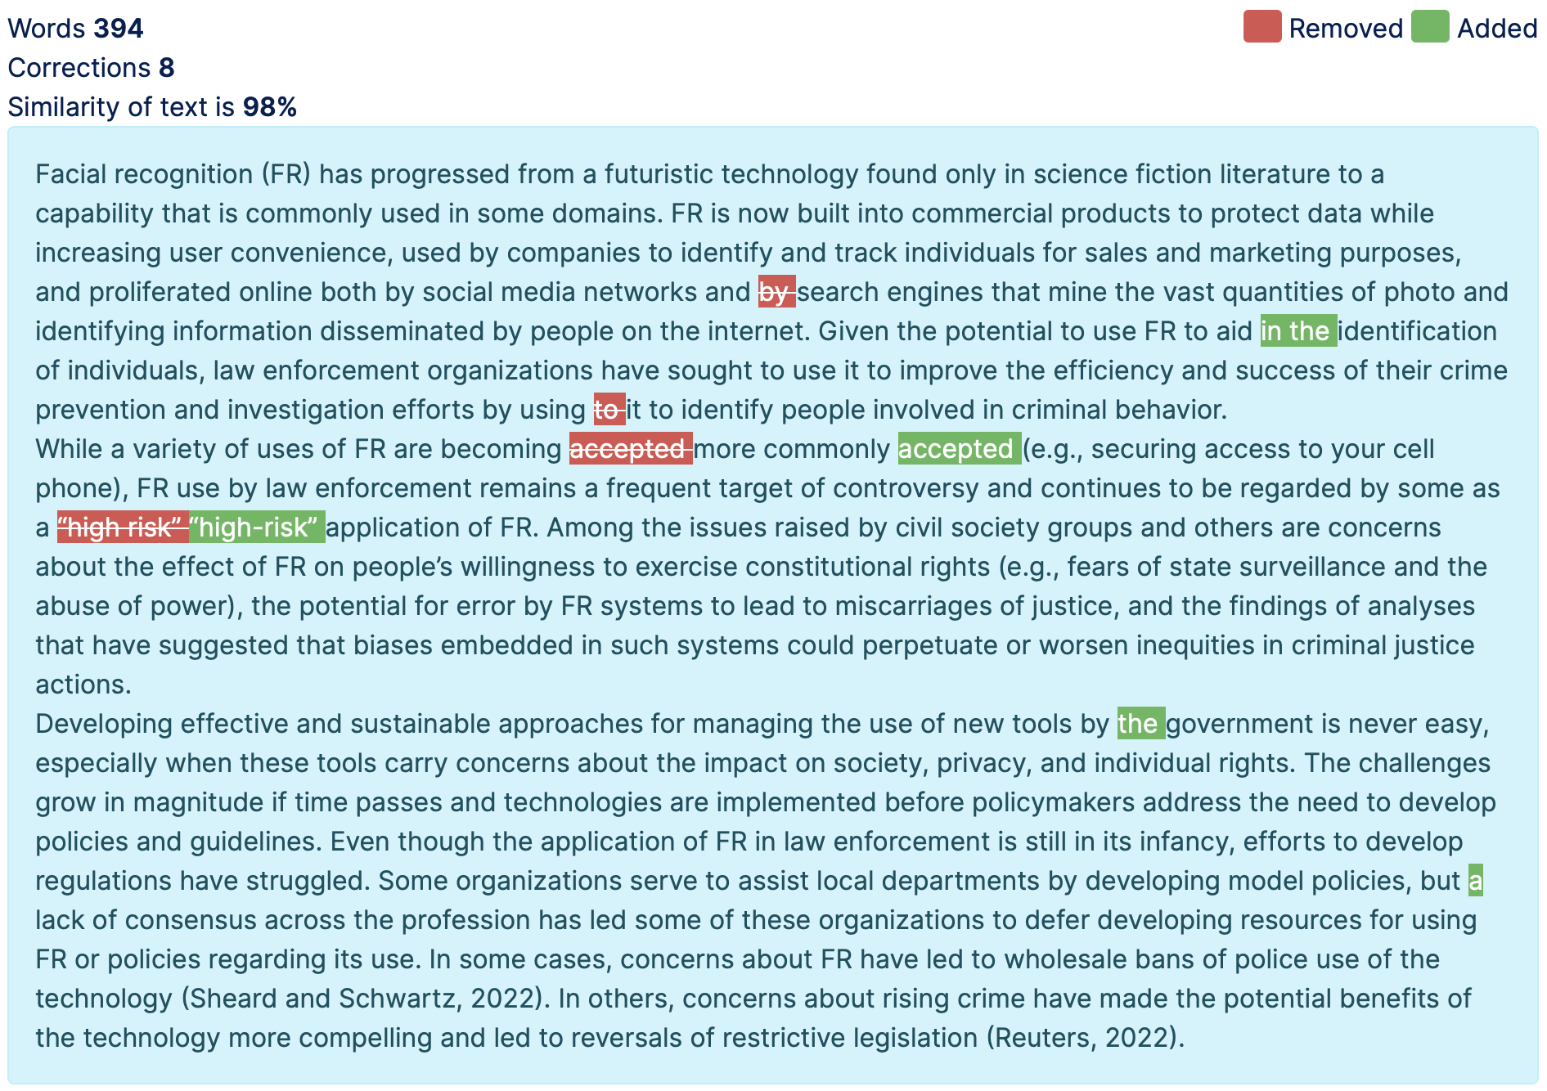
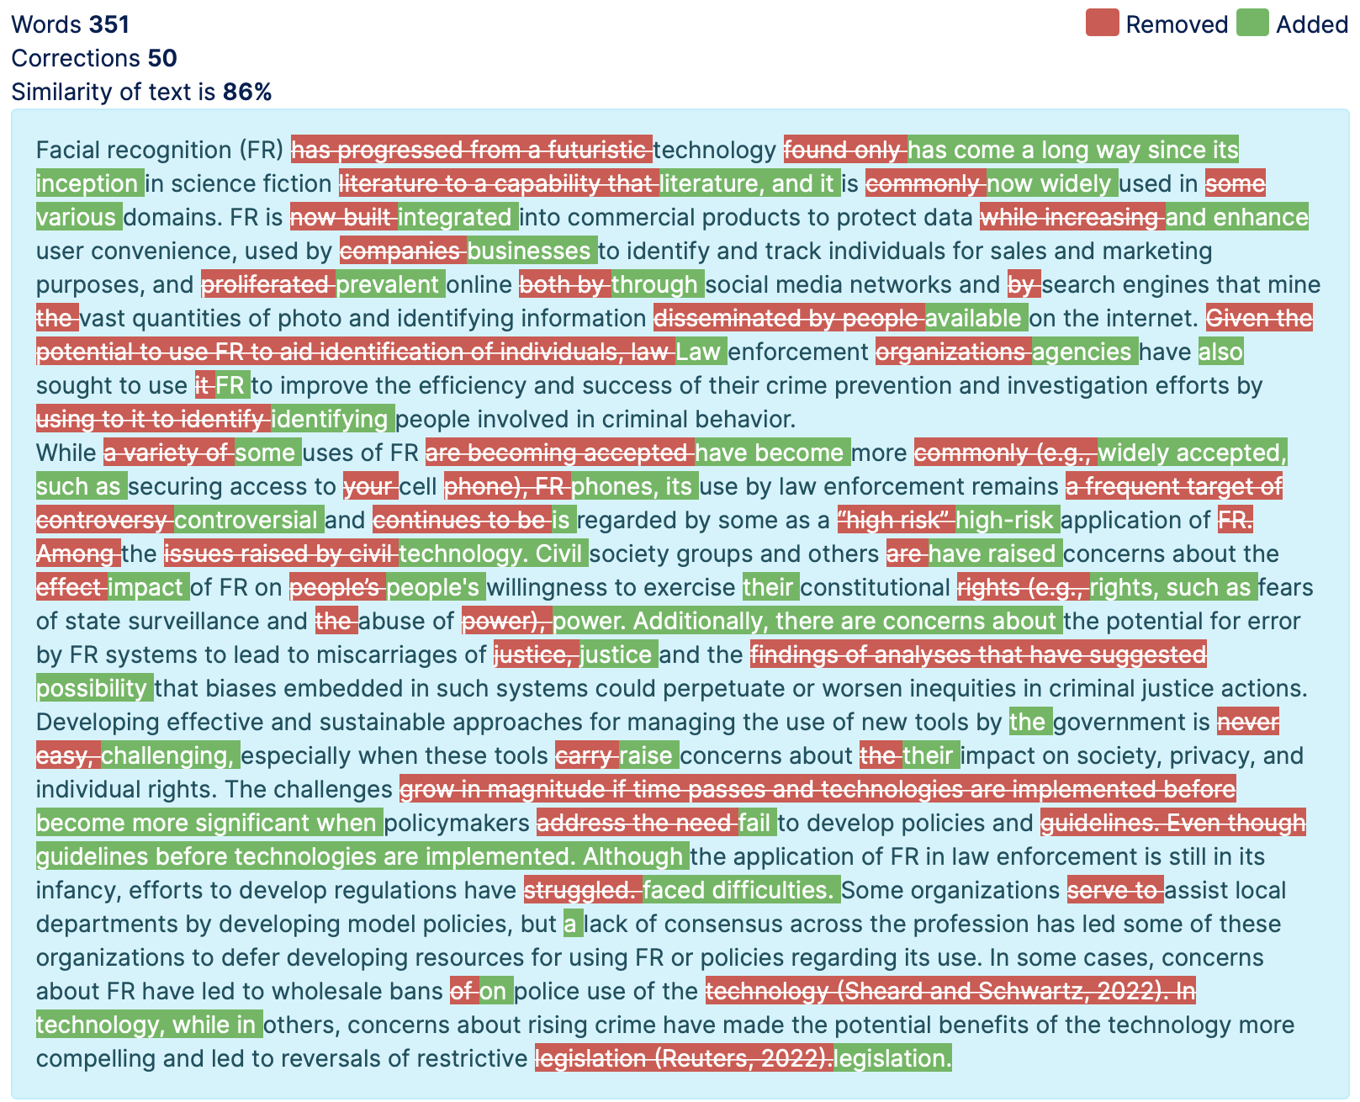
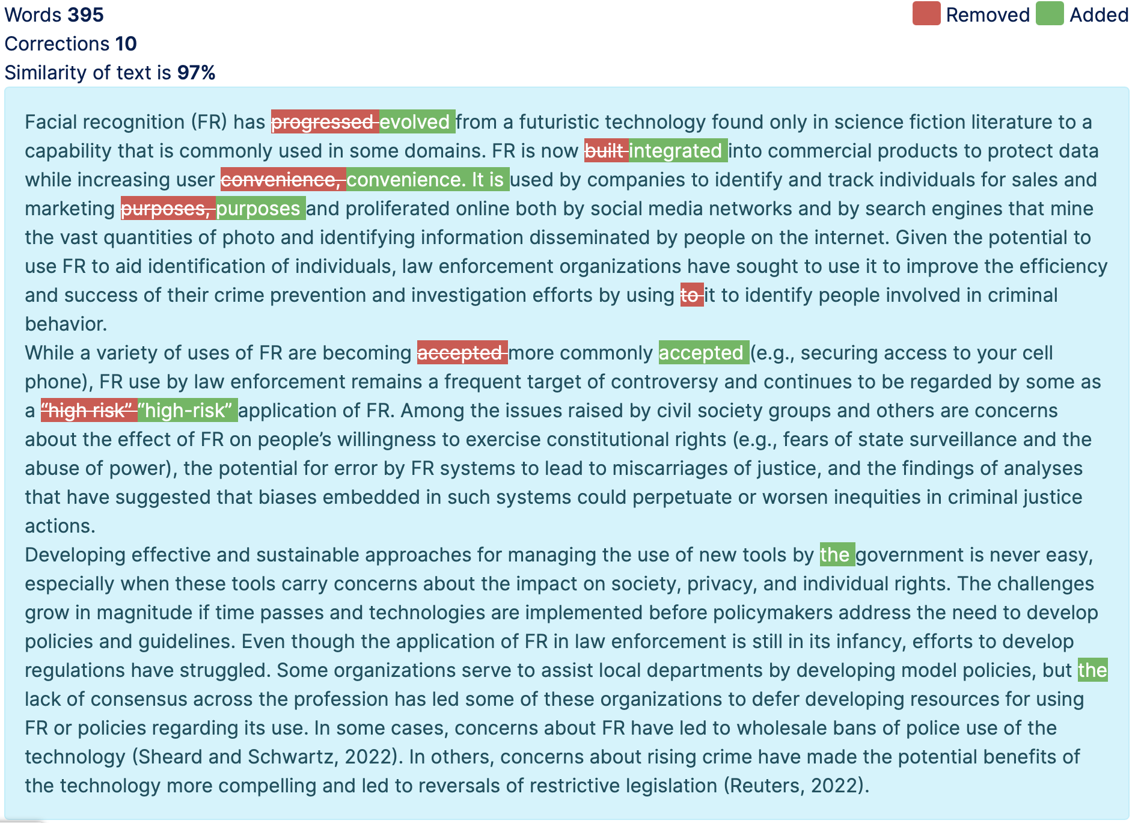
Temperature Effects on “Edit” Results
Low end example
High end example
Temp = .20
Temp = .60
Notes:
Low end underperforming
Highly random
“to it to” piece

Slide 17
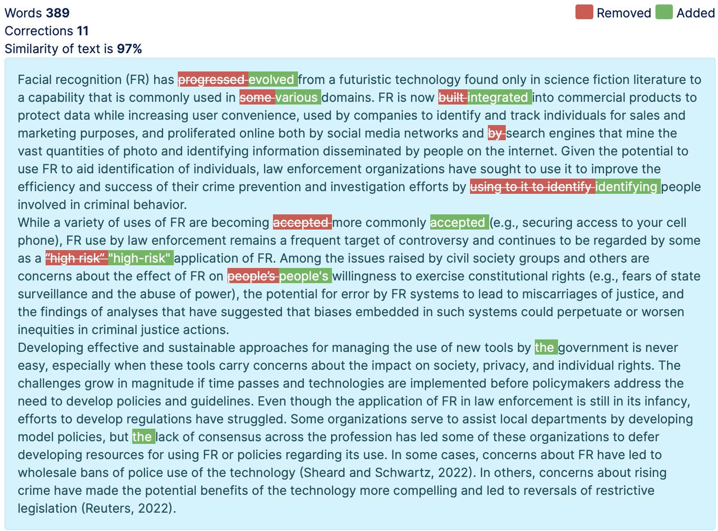
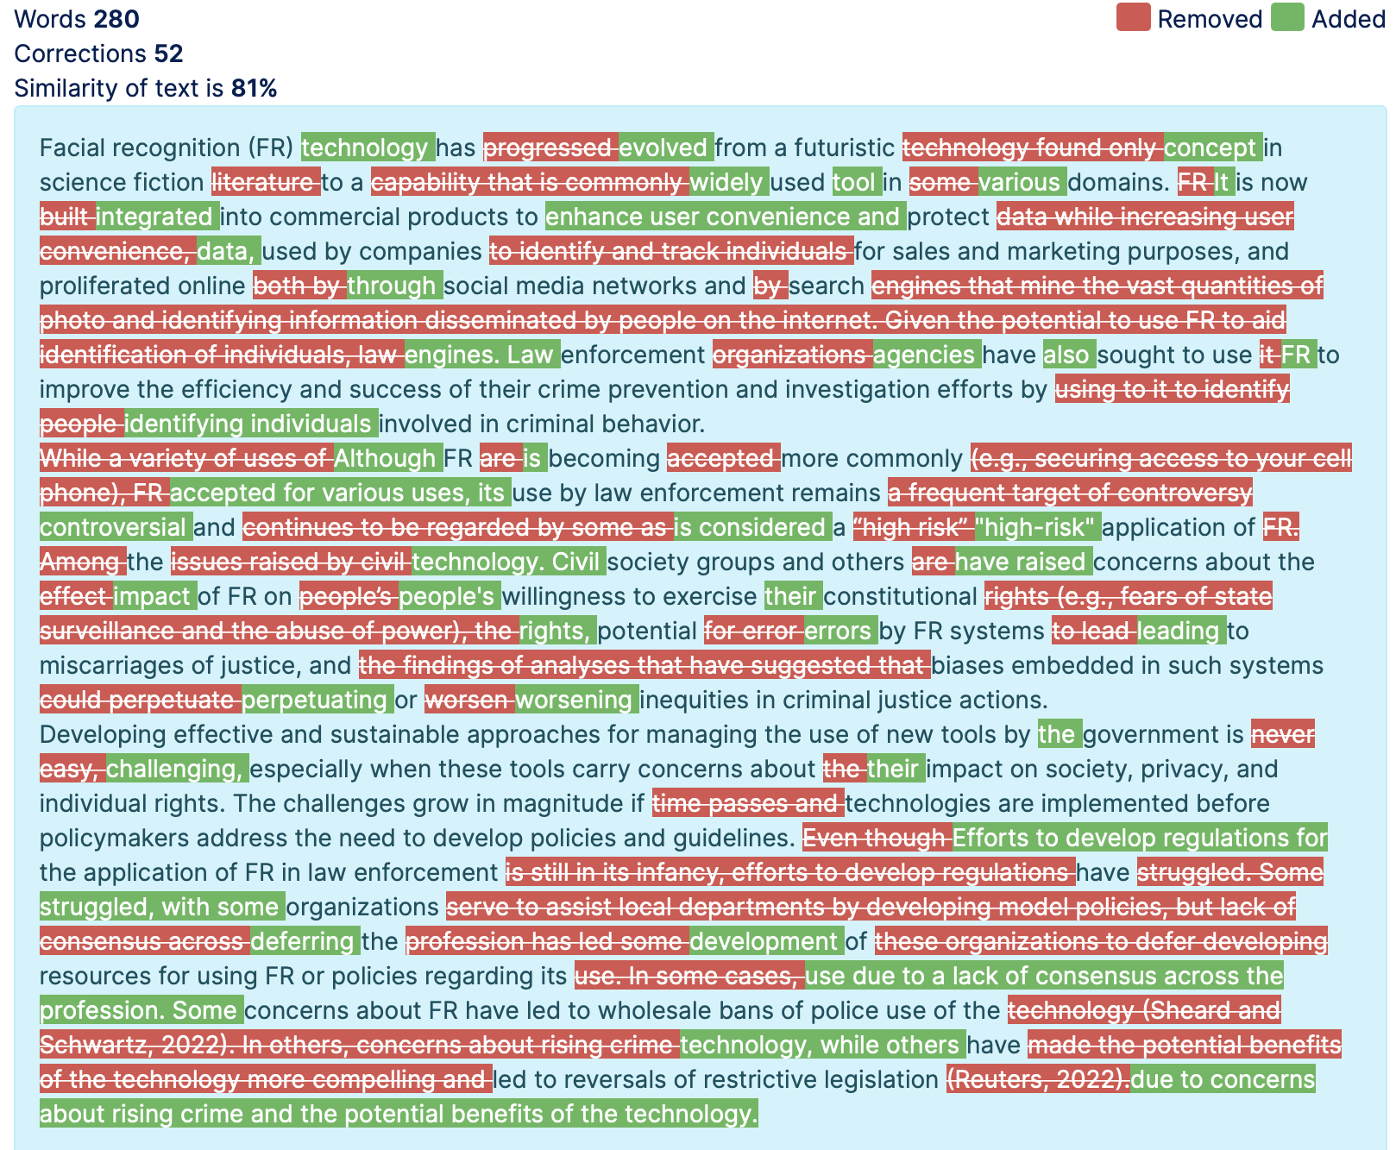
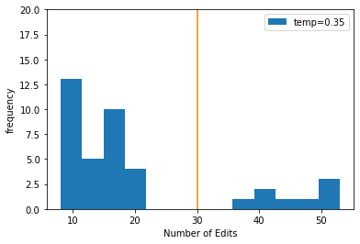
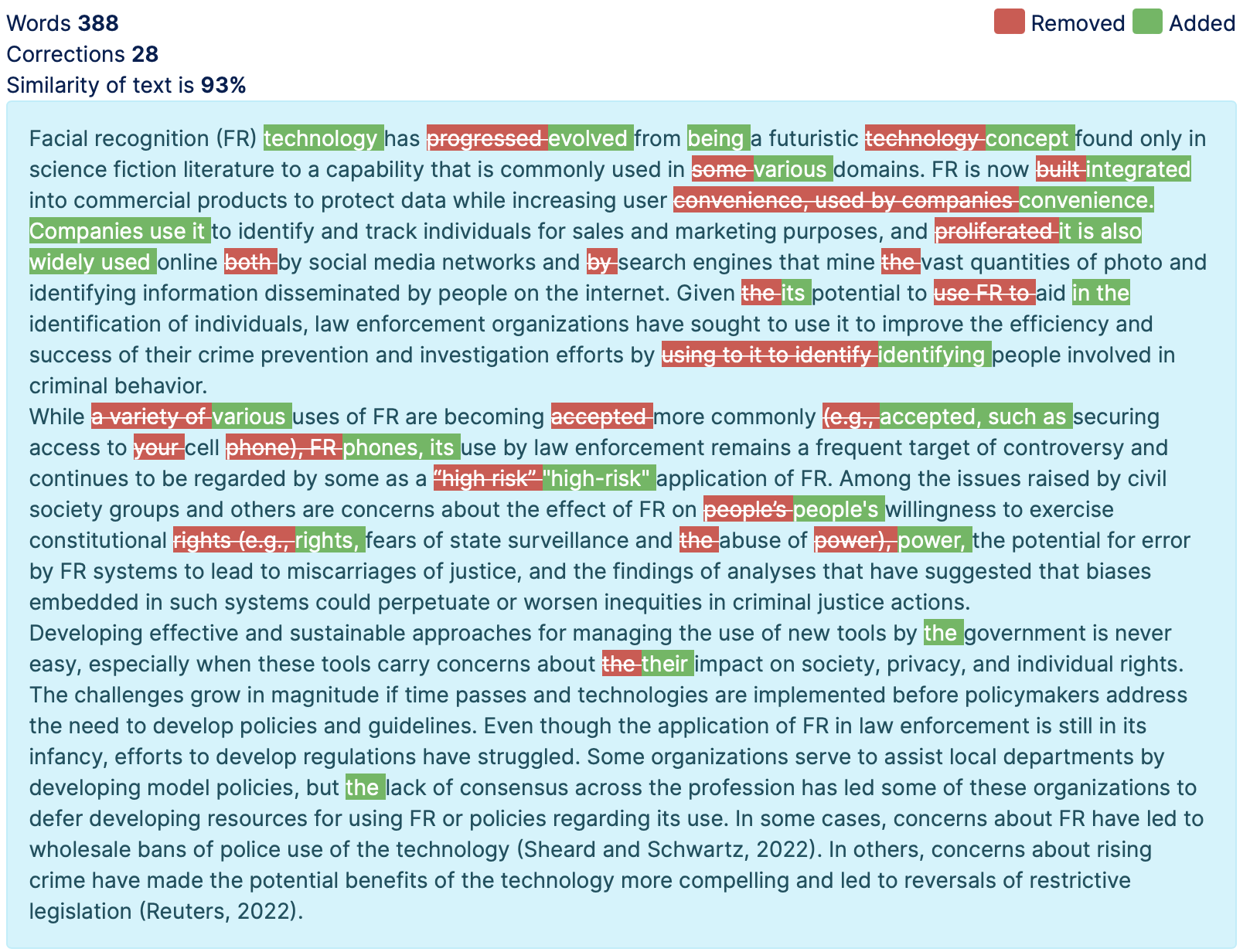
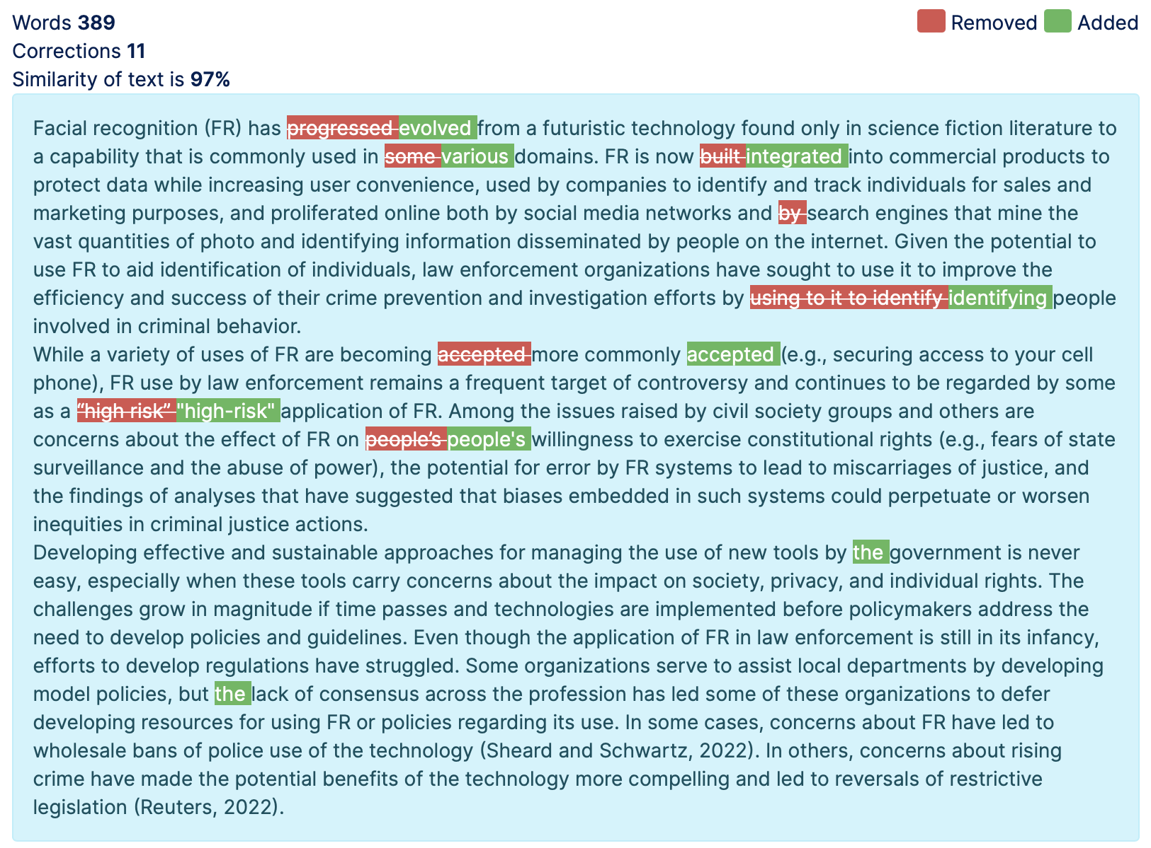
Temperature Effects on “Edit” Results
Notice stochasticity & bifurcation of middle ground
Temp = .35
Notes:
Note longer time

Slide 18
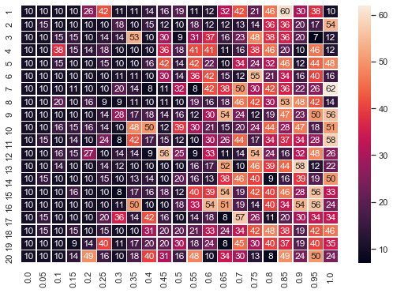
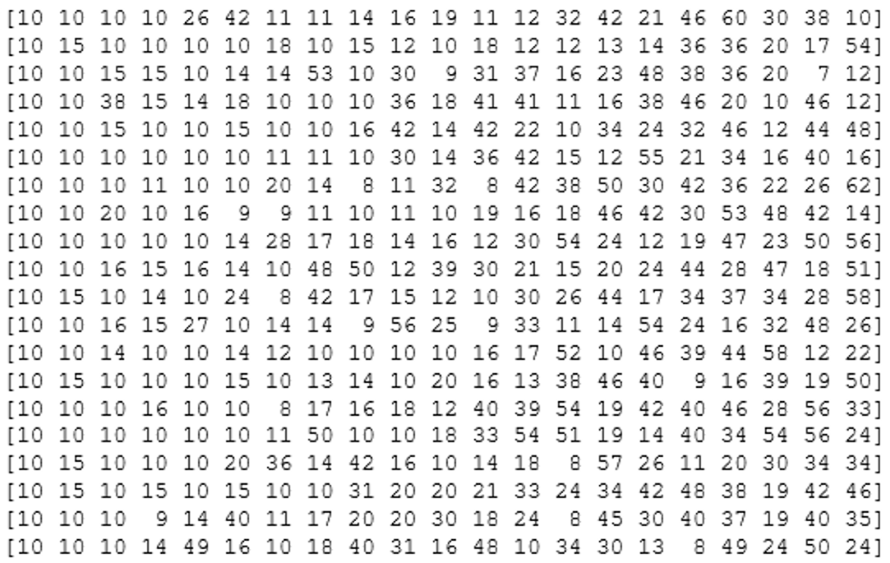
Temperature Effects on “Edit” Results
Stochasticity & bifurcation of middle ground
Temperature
0
1
Different Runs
20
Notes:
Not Agnostic to writer
Occams razor

Slide 19
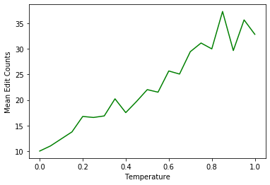
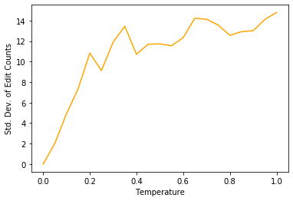
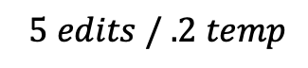
Temperature Effect on Change/“Edit” Counts
$$5 edits / .2 temp$$
VAR
MEAN
Coefficient of Variation:
(temp > .1)
Max @ .30 ~ 70%
Min @ .85 ~ 35%
Notes:
Does underperform at low temperature. Not about “creative edits” but whether edit at all

Slide 20


Framework for Parameter Action (2)
Occam’s Razor

Slide 21
Framework for Parameter Action (2)
Weakly Follows Occam’s Razor Principle
“Occam's razor is the problem-solving principle that recommends searching for explanations constructed with the smallest possible set of elements.” -Wikipedia
~Simple/Small “Edits”
~Busy/Big “Edits”
…
Probability:
.4
.2
.1
.06
.04
.03
.03
.01
Probability “Edit" Size
Notes:
Speak on how the word is not creativity
Froze it to meaningless
Number of assumptions it makes not the type of assumptions

Slide 22


Framework for Parameter Action (3)
(synonymous with “top percent”)
Top_p
0 < Top_p < 1, Default = 1
SoftMax Sandbox
top_p = .75
…
.50
.20
.05
.05
.04
.03
.03
.01
.50
.75
.84
.90
1.00

Slide 23
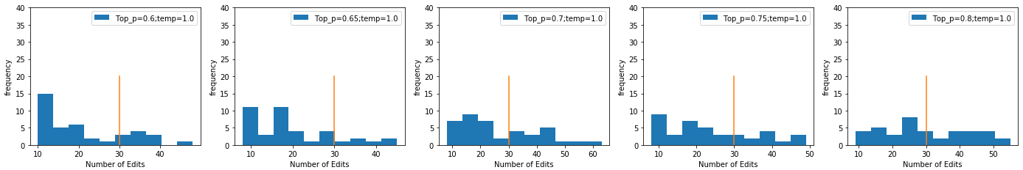
Top_p effects on results
Does not resolve prior issues
Action alike to temperature
- Expect similar behaviors
Heavy “Edits”/Revisions thrown away
- As Top_p decreases
- Sensitive to changes at higher values

Slide 24
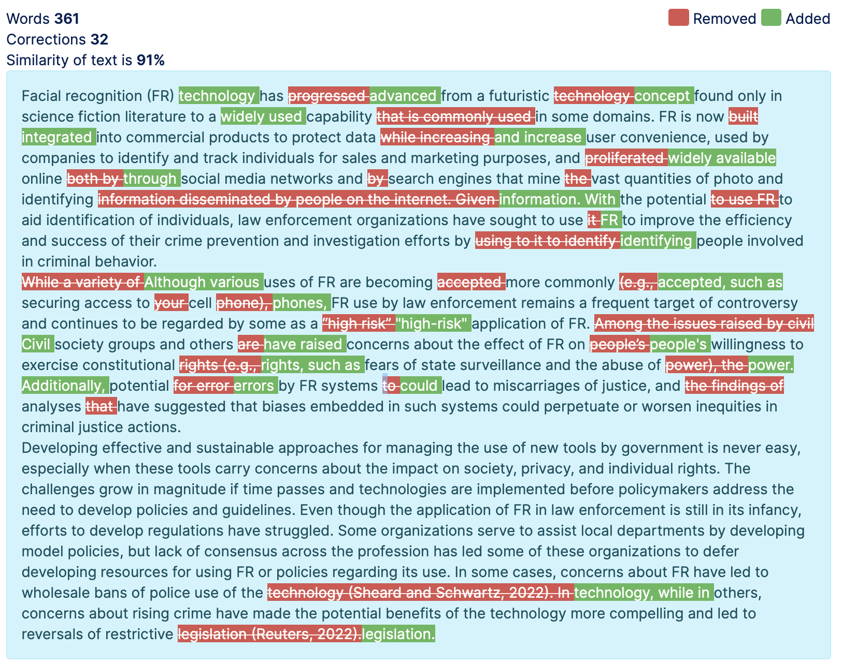
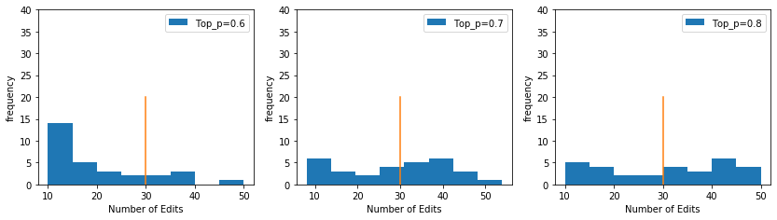
Comment on Holistic Effects
Does not resolve bifurcation issue generally
Did find some promising results:
Temp = 2.0, Top_p = .70
Decreasing: top_p < 1
Increasing: temp > 1
Coefficient of Variation:
top_p = .70 ~ 25%
SoftMax Sandbox

Slide 25

Framework for Parameter Action (4)
Window Seeking
System: Temp| Top_c | (Logit_bias)
Window
…
.4
.2
.1
.06
.04
.03
.03
.01
“Occam’s Window”
Notes:
Was never meant to be used this way
Not a new word, Bayesian model selection
Smaller number of items and similar hopefully in behavior and risk

Slide 26
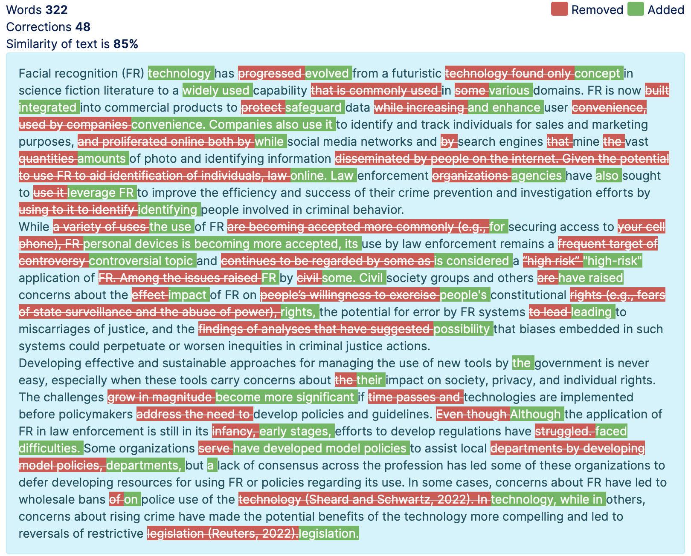
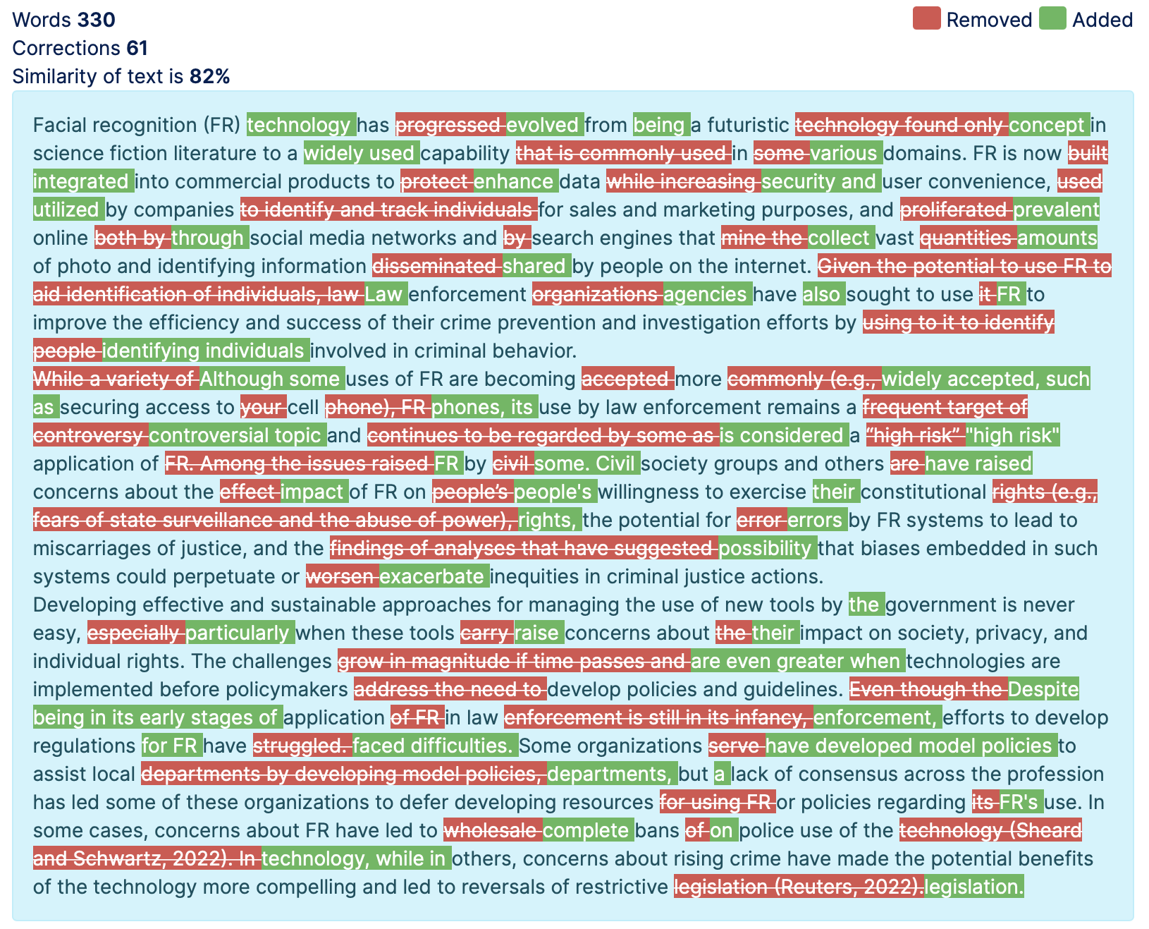
GPT 3.5 vs GPT 4
Class choice may not be an effective differentiator
Note: does not solve bifurcation/jump issue
Has more far-reaching complex changes
GPT 3.5 Turbo
GPT 4
Notes:
May change if document is longer and a more complicated section or issues arise.
Increasing LLM size may not build better editors

Slide 27
GPT in Future Research
Use of Proto-Editor
Partially Viable given Expectation
Three options:
Ask it to do very little
Run it multiple times until you accept the “right” amount of edits
Burden the researcher with abundance of “self-edit” suggestions
Important not to waste researchers time either with overediting and rejecting sample edits
Catches proofreading errors missed by editor’s first pass
Can be spun up locally and securely to handle still sensitive documents as well
Proof of Concept Product:
Gitlab
Notes:
Notes: number of edit not perfect metric bc 1. edits may be different (but okay) 2. need to overestimate
Like a factory without machines, or a factory without people

Slide 28
Next Steps:
Long Documents
Checklist of use cases and with Parameter tuning
Apply RAND Style Guide
High Level Broad Commenting
Reason Parse
Rating Revisions
Complex not “one-shot” changes
Langchain

Slide 29
Research questions may utilize answers via LLM in future
What can you expect?
Lack of Reproducibility
Solution is NOT to reduce temperature
Results are not just, “less creative”
Critical function/ability is lost
Underperforms
Notice it reduced # of edits
Reproducibility possible even with stochasticity
Simulation Science Script Example
No such implementation in GPT API
Possible reasons lacking?
Possible Workarounds
Identify metric or system of metrics
Find Resulting Distribution
Our example was “# of edits”
Make Binary Bins
GPT itself to determine state
Embedding Distance
Dating the use of the LLM
Notes:
Inherently randomness and reproducibility are at tension
Note: thes
Basically, random process
Behavior changed over time

Slide 30
Appendix
Method:
Scripted in Python
40x runs for simulations
Package for docs: Aspose
(non-MacOS)
Online doc tool: gotranscript
Sample Code / Functions: Gitlab
Notes:
Notes: number of edit not perfect metric bc 1. edits may be different (but okay) 2. need to overestimate
Like a factory without machines, or a factory without people

Slide 31
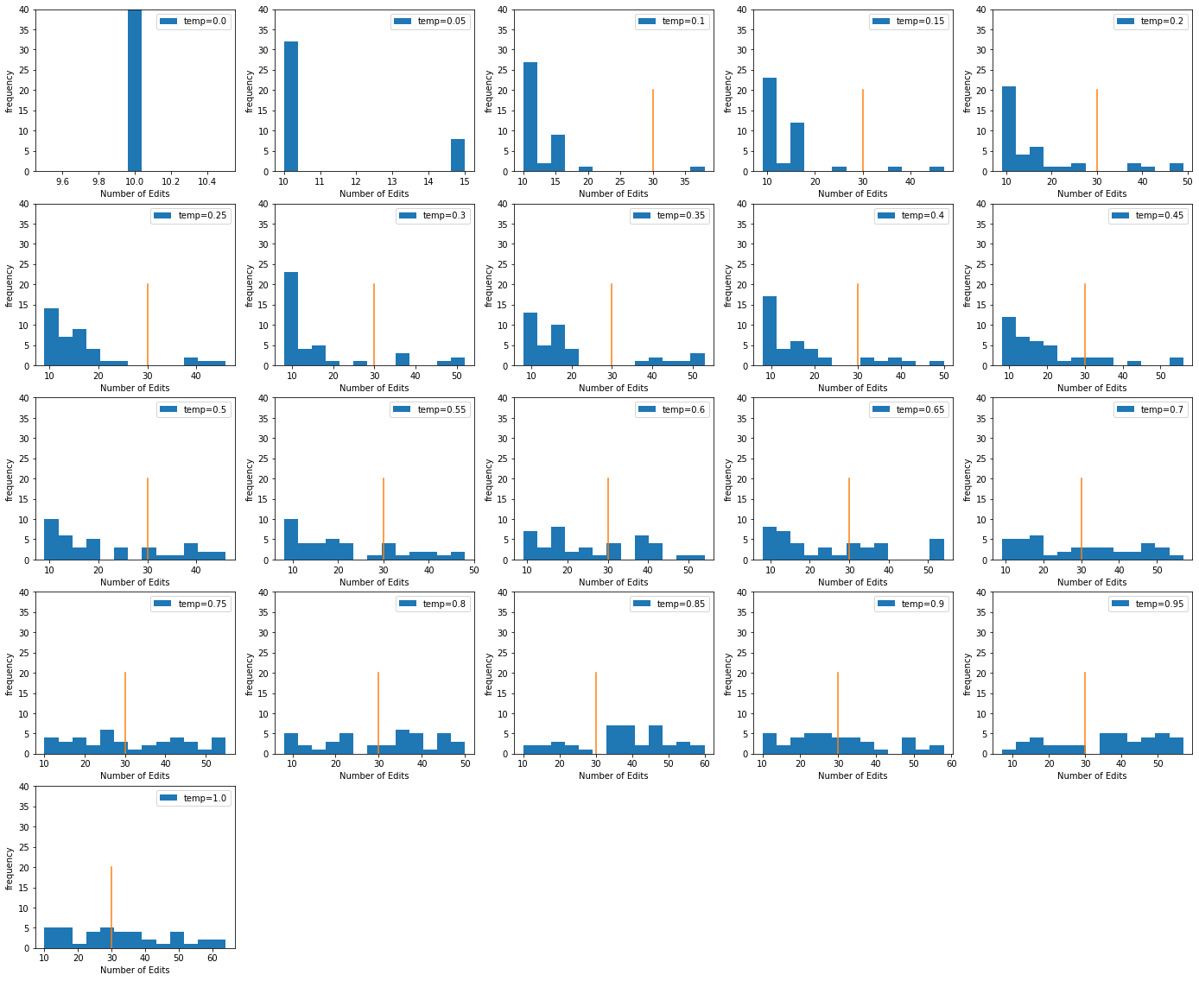
# of “Edit” Counts over temperature
Default
Notes:
Low end underperforming
Highly random
Occam’s Razor

Slide 32






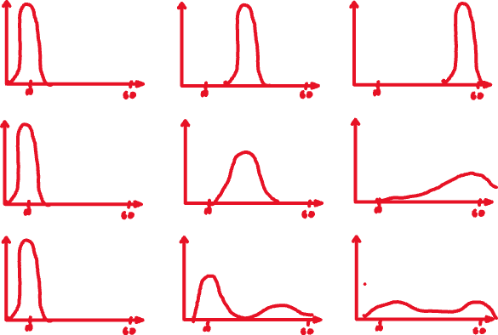


People prompt, AI… laughs
What we…
hoped would happen:
thought might happen:
Is actually happening:
Temperature:
0
.35
1
Notes:
Commissioned to cartoon

Slide 33
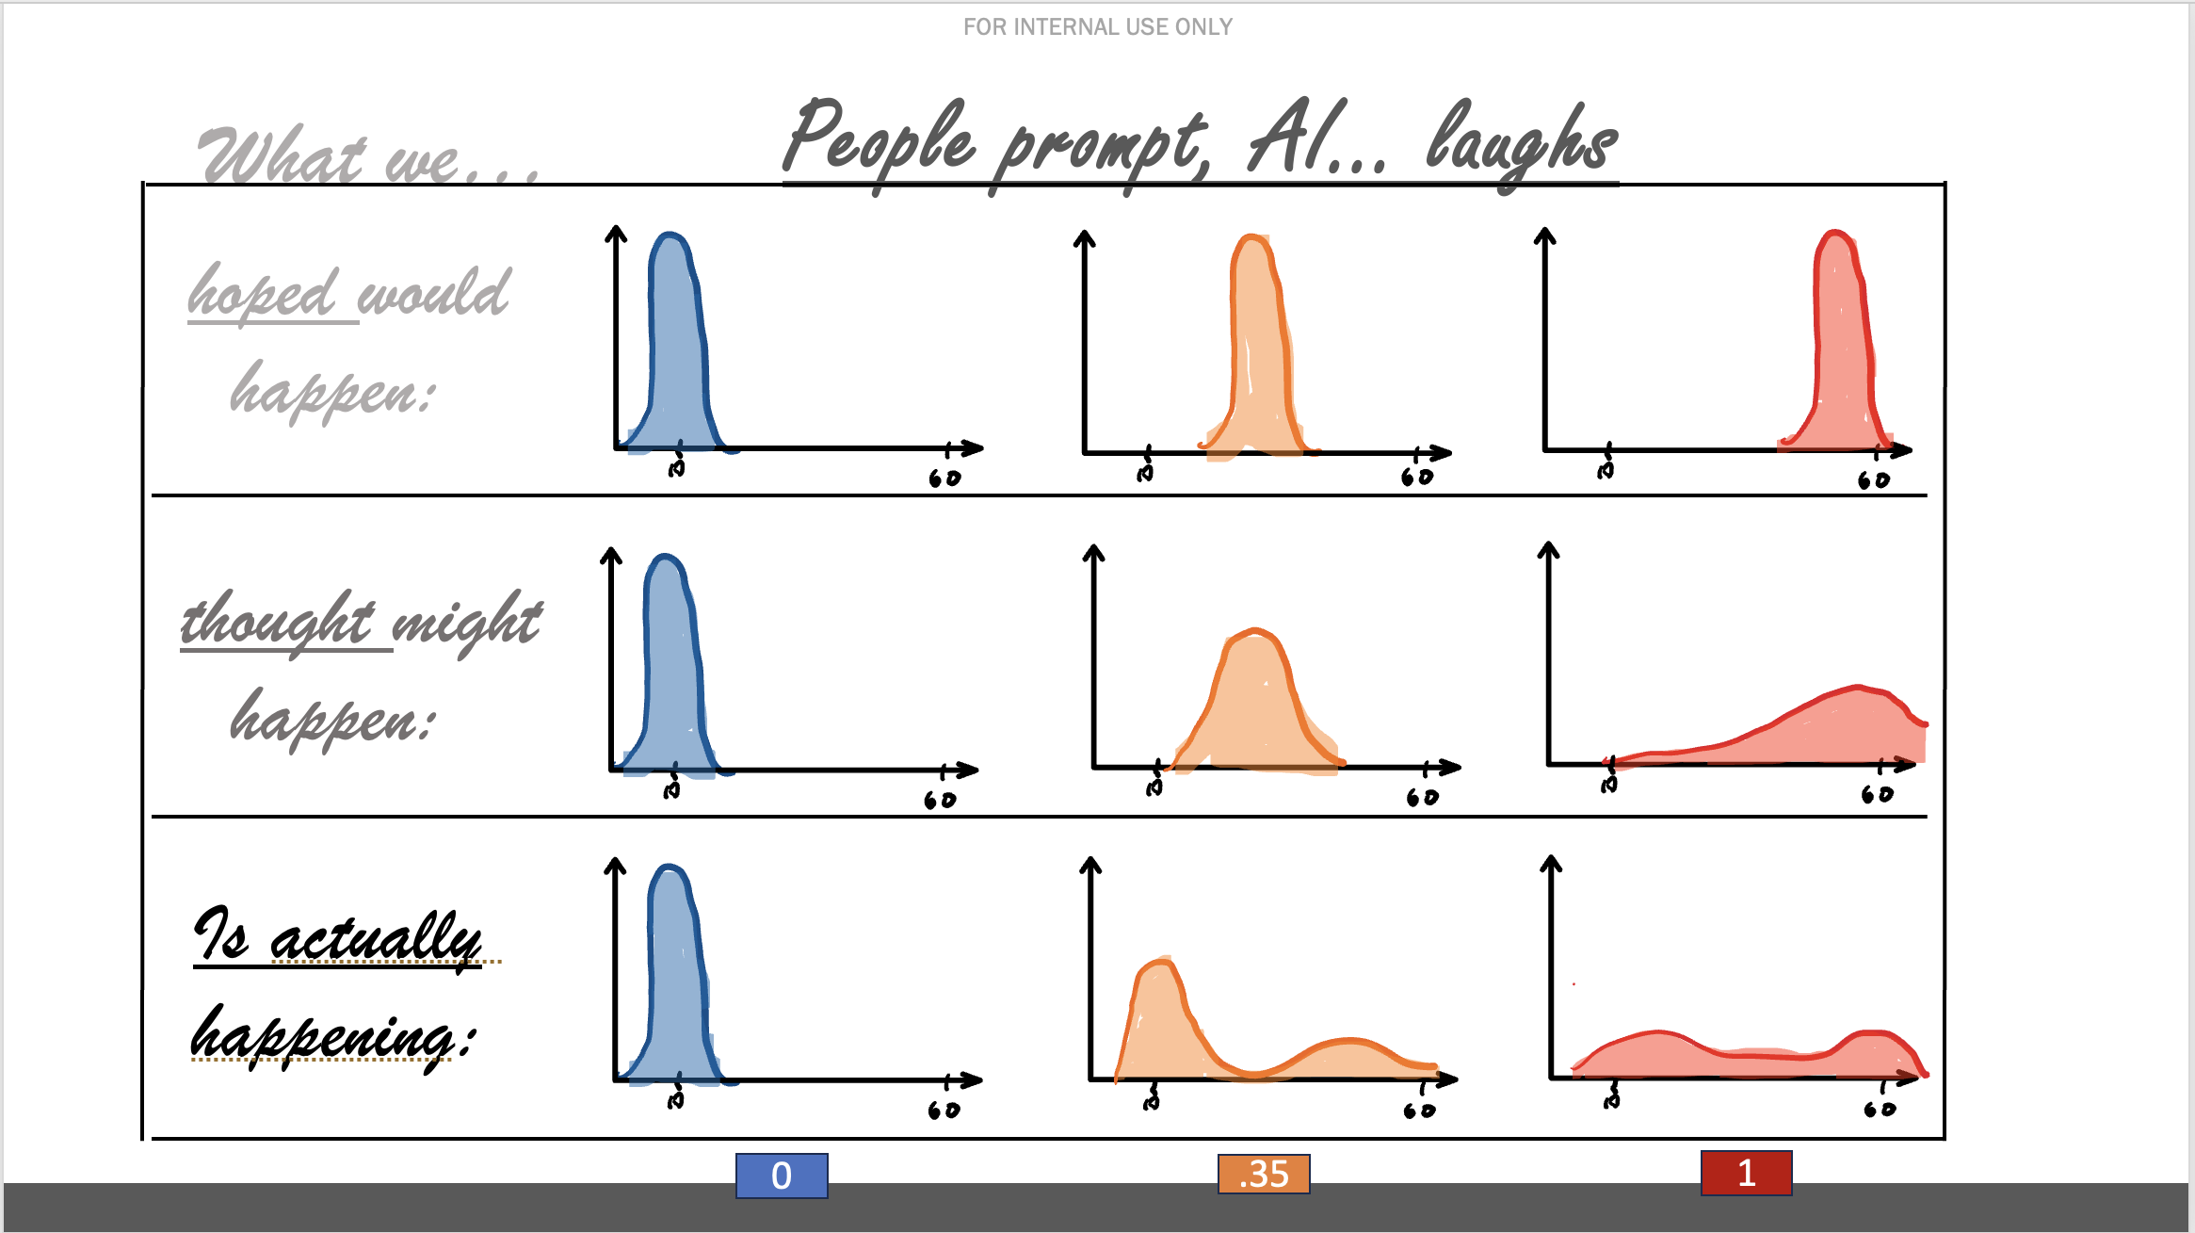
FOR INTERNAL USE ONLY
Thoughts? Questions?
Thank you!
Reach out: vahedi@rand.org ; x5991
GPT help? Reach out: istservicedesk@rand.org
Notes:
Problems? Reach out Gary chuck story

